Slide 1
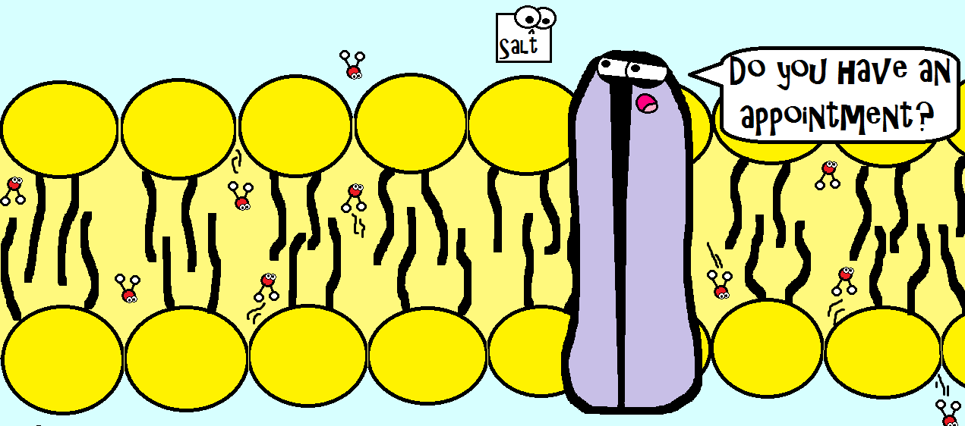
Deciphering the molecular basis and pharmacotherapy of Cystic Fibrosis
Division of Biosciences
BIOS0006 presentation
Zheheng Fan
22009451
Biomedical Sciences BSc.
Supervisor: Dr. Paula Vergani
Notes:
CF is the most common life-limiting genetic disorder in the caucasian population.
Molecular mechanism behind the CFTR channel opening and novel pharmacological approaches to the CF

Slide 2
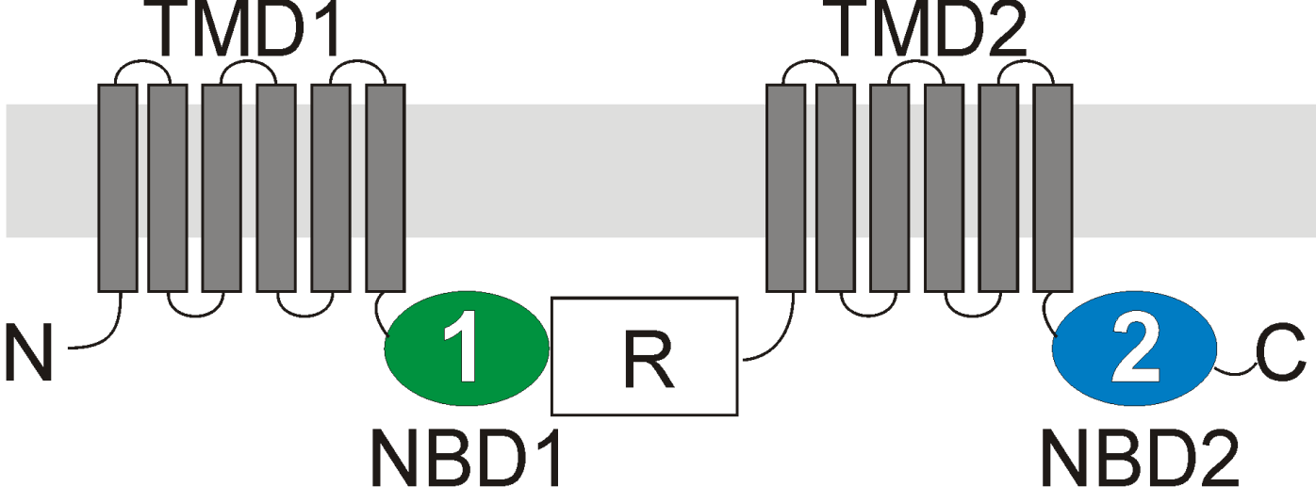
Introduction to CFTR
Glossary
NBD – Nucleotide-binding domain
TMD – Transmembrane domain
ABC – ATP-binding cassette
CFTR is a unique member of the ABC transporter family
Main function:
Allow the flow of Cl⁻ and HCO3⁻ passively down the concentration gradient
5 domains:
two membrane-spanning TMDs, two NBDs, one regulatory R domain
Notes:
CF gene was discovered in 1989
Encodes for the integral membrane protein--CFTR
CFTR (cystic fibrosis transmembrane conductance regulator)
a member of the ATP-binding cassette transporter
only ion channel member of the ABC family
functions uniquely by providing an aqueous pathway allowing the flow of anions passively down the concentration gradient
anions transported are mainly chloride and bicarbonate ions.
When defective: multisystem dysfunction due to abnormal mucus production
Molecular structure of CFTR
like other ABCs, it contains two TMDs (6 alpha helices) which spans the membrane and forms the channel, two NBDs which bind to ATPs and dimerizes to allow channel opening
unlike other ABCs, it contains an R domain and R domain phosphorylation is a prerequisite for channel opening.

Slide 3
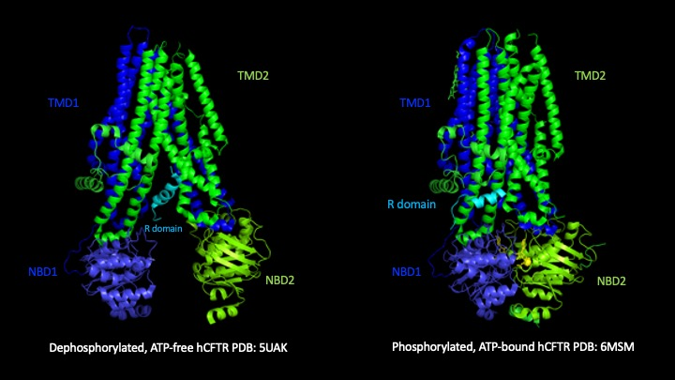
CFTR mechanism of opening
R-domain phosphorylation regulates CFTR channel opening
R domain is phosphorylated by cAMP-dependent kinase A (PKA) and protein kinase C (PKC)
Phosphorylation of the R domain is a prerequisite for channel opening
Notes:
Two molecular structures of different forms of hCFTR are shown.
In the dephosphorylated state
the R domain is wedged in between the NBDs and TM helices 9,10,12, inhibiting the dimerisation of NBDs
R domain contains consensus sequences recognized by PKA and PKC → Phosphorylation
In the phosphorylated state
the R domain is moved away from its occluded position hence no longer inhibits the dimerisation of NBDs
Phosphorylation is a prerequisite
Channel opening is dependent on ATP

Slide 4
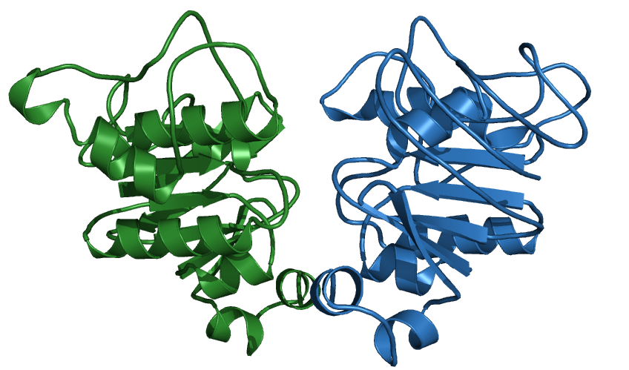
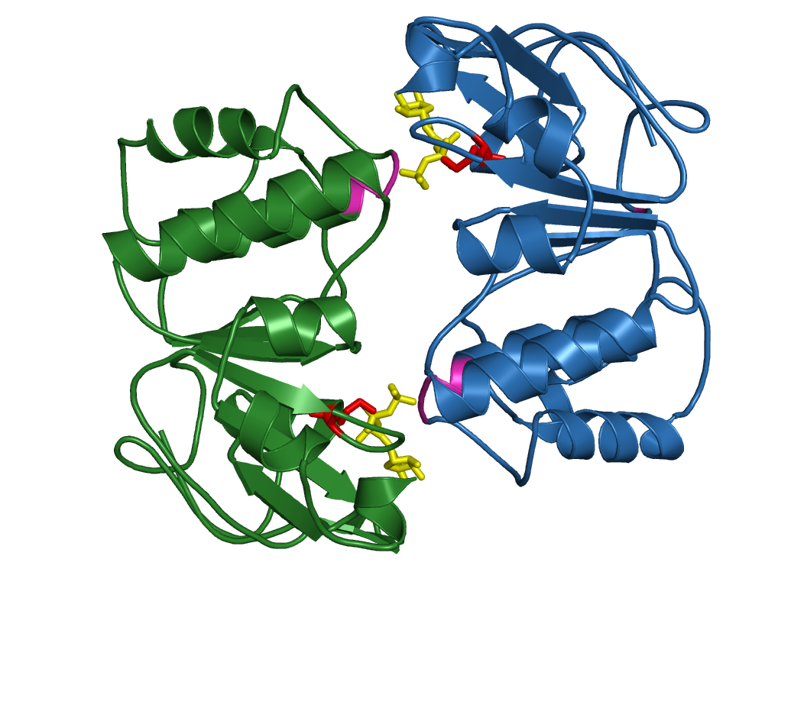
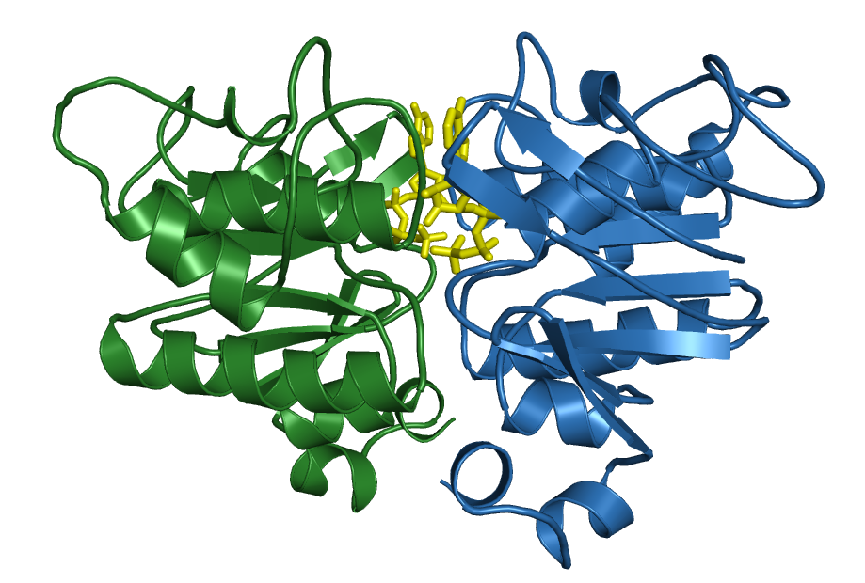
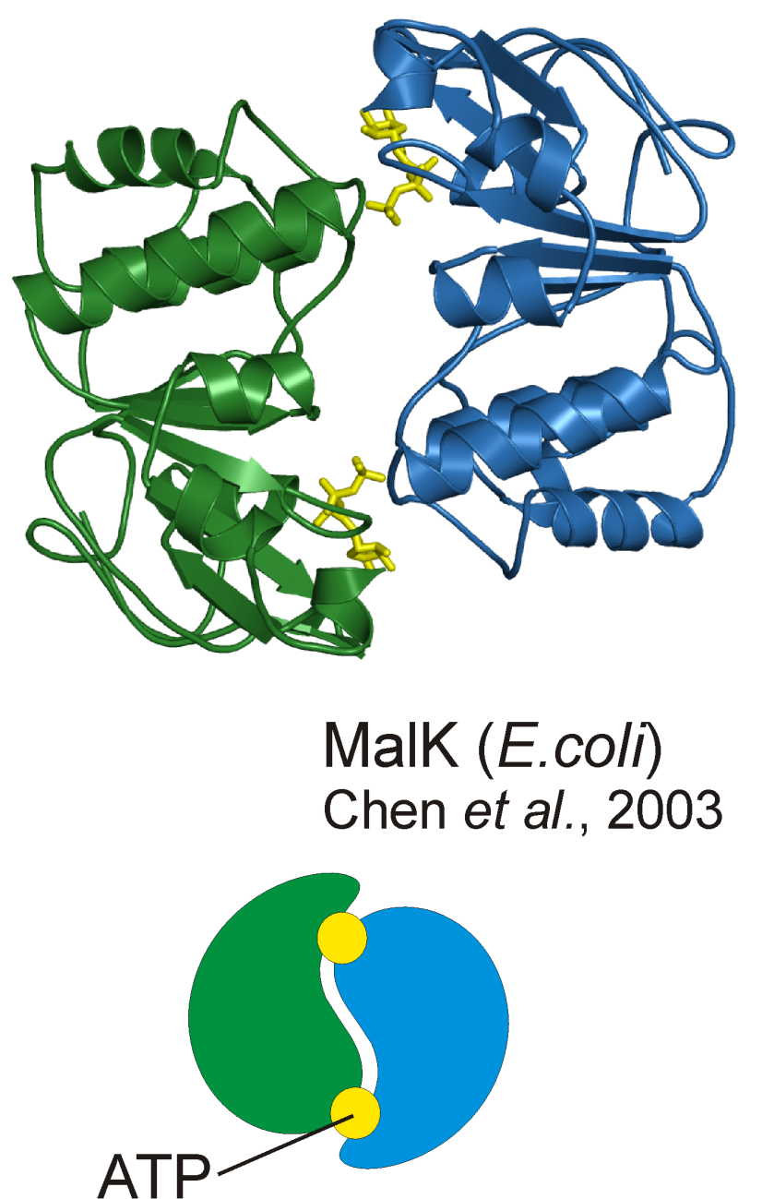
ATP-dependent dimerization of NBDs drives CFTR channel opening
CFTR mechanism of opening
ATP
Glossary
Signature motif/ Lasso motif/ LSGGQ motif → Labelled pink
Walker A and B motif → Labelled red
ATP-bound dimerized NBDs
Two NBDs form a rotationally symmetrical head-to-tail dimer
The dimerization signal is transduced to the TMDs to allow channel opening
Notes:
NBDs key motifs
Signature motif/Lasso/LSGGQ (Pink), Walker A and Walker B motif (Red)
The signature motif from the tail region of one NBD and the Walker motif from the head region of the other form the composite site
→ Rotationally symmetrical head-to-tail dimer
The gamma phosphate of ATP provides molecular contacts with both sides of the composite site (Hydrogen bonds) → dimer stability

Slide 5
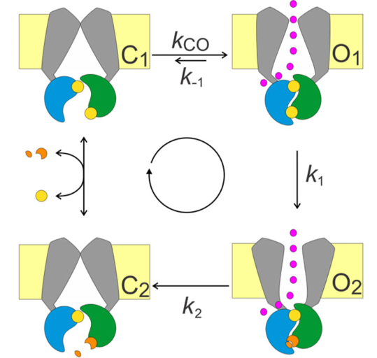
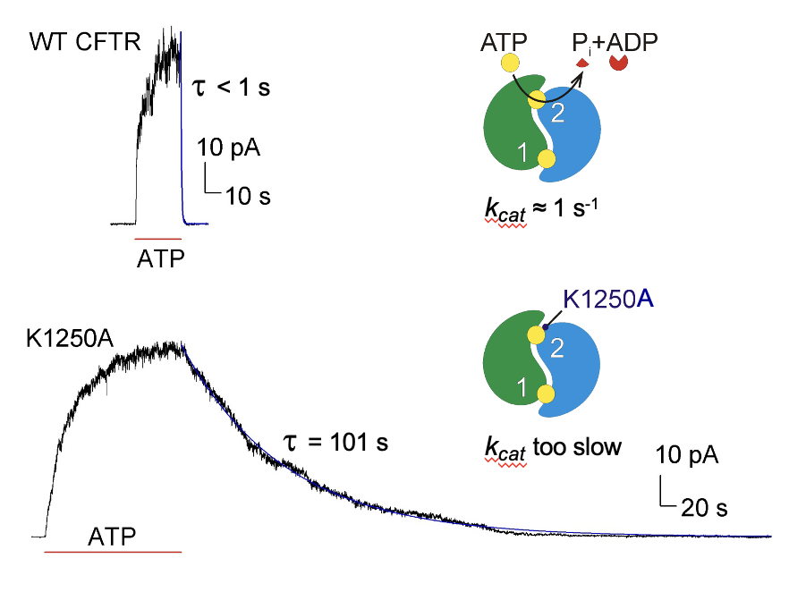
ATP hydrolysis and gating cycles
CFTR mechanism of opening
Glossary
K1250 – Walker A lysine in NBD2, forming composite site 2
τ_{b} -- burst duration
K1250A is not a disease-causing mutation
Langron et al. (2018)
Most WT-CFTR favours the hydrolytic pathway (C₁→O₁→O₂→C₂→C₁)
For mutants that abolish ATP hydrolysis at site 2, they undergo the non-hydrolytic pathway (C₁→O₁→C₁)
K1250A mutation greatly increases the burst duration and it closes completely via the non-hydrolytic pathway
Notes:
After Inward facing → Outward facing (Dimerization)
Channel enters O1 state
Once enters, two ways of closing:
Hydrolytic pathway
Non-hydrolytic pathway
For WT, most channels closes via the hydrolytic pathway. Considering kinetics, k1 is much larger than k-1
For some mutants that completely abolish ATP hydrolysis at site 2, they can only close via the slow non-hydrolytic pathway.
Composite site 1 is non-hydrolytically active
Composite site 2 is hydrolytically active. The ATP hydrolysis at site 2 is strictly coupled to the gating cycle

Slide 6
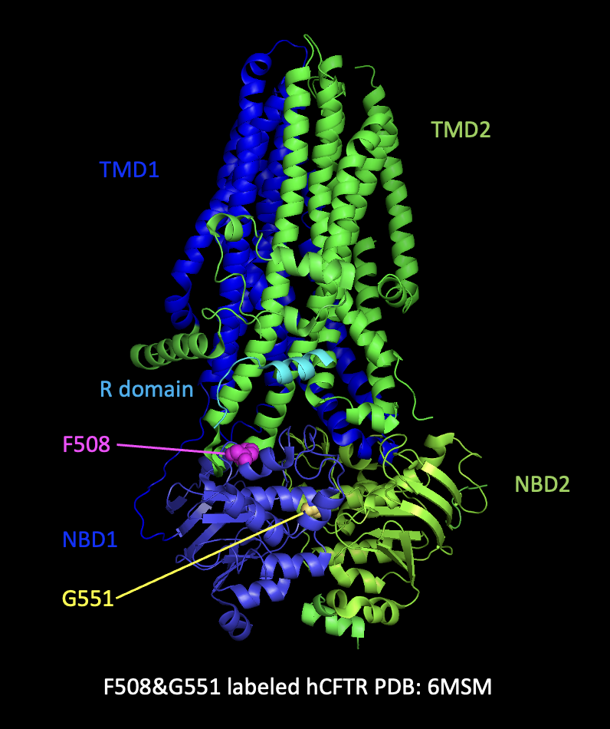
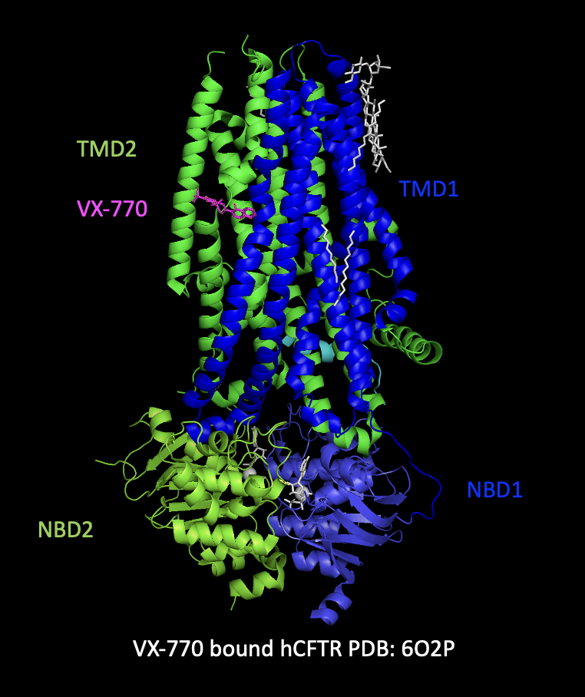
Common CFTR mutations and CFTR potentiator
CFTR modulators
Glossary
VX770 (Ivacaftor)
-- First FDA-approved CFTR potentiator for G551D mutation
VX770 increases the open probability of CFTR by stabilizing the pre-hydrolytic O₁ state
VX770 is life-changing for CFTR gating defect mutations → combination with correctors necessary for rescuing defective folding mutations
Notes:
CFTR mutations
F508del → 90% carry F508del in at least one of the alleles → 99% CFTR is ubiquitinated and degraded in ER
G551D → 5% of patients carrying it → channel number is normal at PM → remain closed
VX770
First FDA-approved CFTR potentiator for G551D
Increases Po
Exact mechanism of VX-770 is unclear
Life-changing → Combination

Slide 7
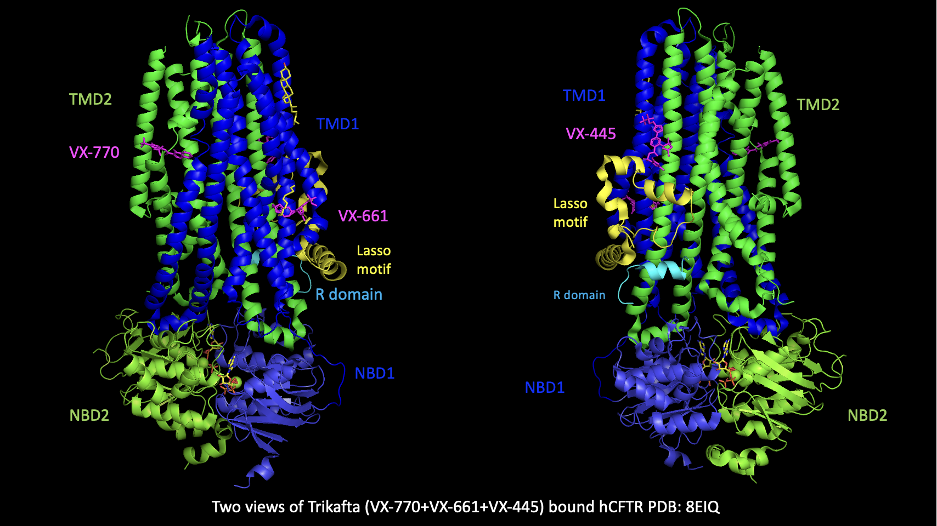
CFTR correctors in combination with potentiators
CFTR modulators
Glossary
Trikafta – Approved by FDA for patients with one copy of F508del
VX-661 (Tezacaftor) – Type I corrector
VX-445 (Elexacaftor) – Type III corrector
VX-770 (Ivacaftor) – Potentiator
Trikafta = VX-770 + VX-661 + VX-445
VX-661 and VX-445 act synergistically and greatly improve the biogenesis of CFTR
Trikafta greatly improves lung function of F508del patients
Notes:
VX-661 stabilizes TMD1
VX-445 allosterically stabilizes NBD1
Synergy effect as they have different binding sites

Slide 8

Thank you! Q&A

